Slide 1

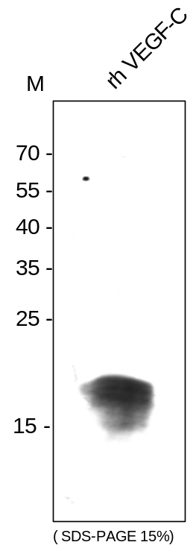
ReliaTech GmbH
Mouse anti-human VEGF-C
(Cat #101-M91)
Figure 1. Western analysis of recombinant human VEGF-C [Cat# 300-078] derived from insect cells using a monoclonal antibody directed against recombinant human/rat VEGF-C.
http://www.reliatech.de / orders@reliatech.de

